Slide 1
Spectral Collaborative Filtering
Roline Stapny Saldanha

Slide 2
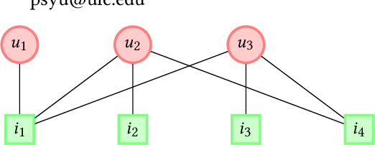
Motivation
Collaborative Filtering(CF) based methods suffer from cold start problems, which negatively impacts the user experience in Recommender Systems.
Figure 1: A toy example of a user-item bipartite graph B with edges representing observed user-item interactions. Red circles and green rectangles denote users and items, respectively.
Which items to Recommend user u1 ???

Slide 3
Motivation
Using CF-based i2, i3 and i4 are recommended. But Which one of the 3 recommendations are most reliable to u1?
The key to the answer lies in user-item connectivity information.
If we take a look at the graph, we can see that there is one path between u1 and i2(or i3), while there are 2 paths from u1 to i4. So i4 is a reliable recommendation for u1.
Existing CF-based methods fails to model this connectivity information.

Slide 4
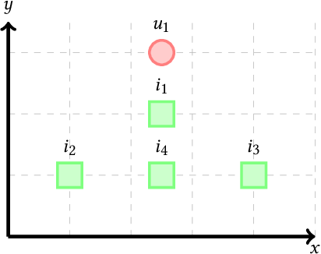
Motivation
Spectral Domain
The connectivity information hidden in the graph is revealed by spectral domain.
This paper implements a CF-based method which is learnt from the spectral domain of user-item bipartite graphs.

Slide 5
Main technical contributions
Novelty : This work claims to be the first CF based method that directly learns from spectral domains of user-item bipartite graph.
A deep recommendation model : The paper proposes a new spectral convolution operation for the spectral domain. Multiple such spectral convolution layers are stacked to form a model named Spectral Collaborative Filtering(SpectralCF)
Strong Performance : SpectralCF effectively utilizes both proximity and connectivity information of spectral domain to ease the cold start problem.

Slide 6
Main technical contributions
The relationship between the user and item is formalated as a bipartite graph.
Spectral graph theory is used to leverage the rich information present in the Spectral domain of the user-item bipartite graph.
This paper focuses on the recommendation problem for implicit feedbacks.
SpectralCF finds the deep connections between users and items which alleviates the cold start problem.

Slide 7
Main technical contributions
To solve the difficulty of learning from spectral domain, a new spectral convolution operation to dynamically amplify and attenuate each frequency domain in introduced.
The new spectral convolution,
Uses polynomial approximation for the filter to make its number of parameters independent from the number of vertices.
Generalizes the user and item nodes to C channels to learn C dimensional embeddings for each user and item nodes.

Slide 8
Main technical contributions
Spectral Convolution is then generalized to C channels and F filters using classic convolution methods.
The Spectral Convolution operation learns an embedding for each user and item node using the information from the spectral domain of the user-item bipartite graph.
A deep model is create by stacking these spectral convolution layers, and embeddings from each layers are concatenated.

Slide 9
Experimental results
Quality of Recommendations for cold-start Users
Dataset : MovieLens-1M
Training dataset was built to contain different degrees of sparsity, by varying the number of items associated with each user denoted as P(from 1 to 5).
All the remaining items associated with users are used as test set.
SpectralCF is compared with a strong performer BPR.

Slide 10
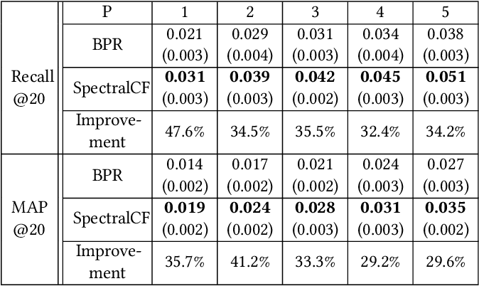
Experimental results
In Table, we see that due to cold start problem the performance of BPR and SpectralCF inevitably degrade.

Slide 11
Experimental results
Regardless of the number of items(P) associated with users, SpectralCF consistently outperforms BPR in terms of Recall@20 and MAP@20.
On average, SpectralCF improves BPR by 36.8% and 33.8% in Recall@20 and MAP@20 respectively.
Hence, the paper shows that compared with BPR, SpectralCF can better handle cold-start users and provide more reliable recommendations.

Slide 12
Limitations
Eigen decomposition is a main operation in this paper.
It is to convert the user-item bipartite graph into spatial domain. This is very time consuming as in practice the Recommendation matrix is very huge.
Hence the Eigenvectors and Eigenvalues were precomputed by the author. This makes the system hard to scale.

Slide 13
My thoughts
This work could be tested on only non cold-start users to see if the results are consistent as mentioned in paper. ( The paper however tests the implementation on cold-start+non cold-start users)
This work could be extended to explicit dataset by changing the initial binary matrix to rating matrix.

